Slide 1
Principles of Drug Discovery
Lecture 7: ADMET
Notes:
6/26/17
1
1

Slide 2
Absorption
Distribution
Metabolism
Excretion
Toxicity

Slide 3
From the previous lectures we have learned how to find molecules which show activity on the target we are interested in, either by screening or by starting from a known active molecule.
If we have confidence in the hits and were able to establish some basic understanding of the structure-activity relationships (SAR) such a series of compounds is called a lead series which has the potential to be developed into a new drug.
From a lead series to a drug there is a long way to go in terms of chemical optimization. What kind of properties have to be optimized and what the basic concepts of lead optimization are will be subject of this lecture.

Slide 4
Drug Discovery Projects
Discovery Research
Target Discovery
Hit Finding
Lead Optimization

Slide 5
What is drug?
There are mainly two reasons why drug candidates fail in clinical trials:
Insufficient efficacy
Insufficient safety
The balance between safety and efficacy is not acceptable

Slide 6
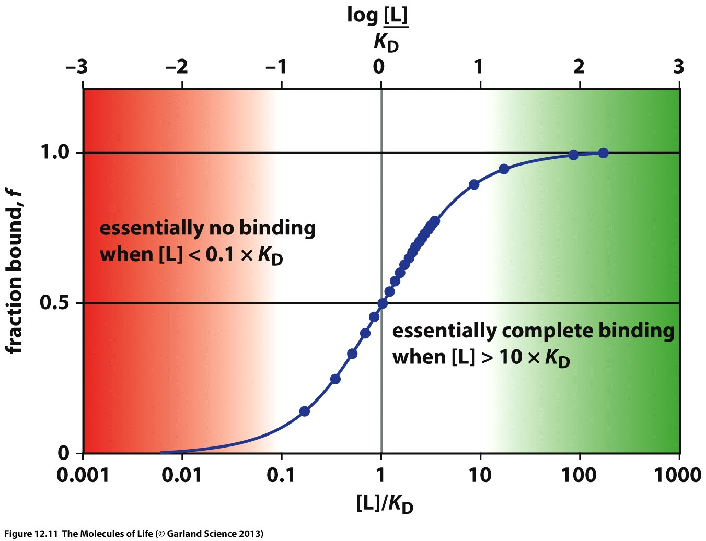
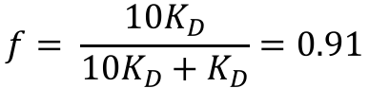
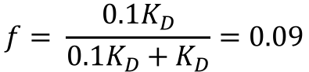
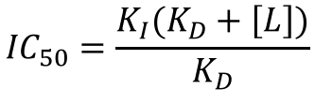
Efficacy
The minimum prerequisite for a drug candidate to be efficacious is that it is present at the location where the target is in concentrations which are sufficient to modulate its biological function.
$$f= \frac{{10K}_{D}}{{10K}_{D}+K_{D}}=0.91$$
$$f= \frac{{0.1K}_{D}}{{0.1K}_{D}+K_{D}}=0.09$$
f: fraction of protein bound to ligand
$${IC}_{50}=\frac{K_{I}(K_{D}+\left[L\right])}{K_{D}}$$

Slide 7
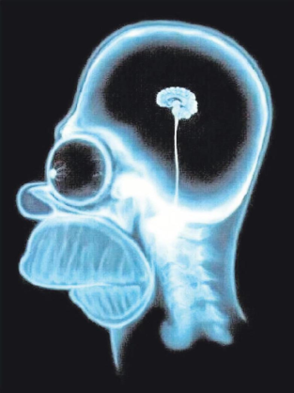
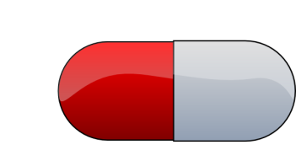

Bioavailability
Analysis of clinical trial failures in the early 90s showed that a significant number of failures can be attributed to poor bioavailability.
Target
Brain
Mouth
Portal vein
Stomach (pH=1)
Liver
Blood -
Systemic Circulation
Intestine (pH=7)
Metabolism
Gut wall

Slide 8
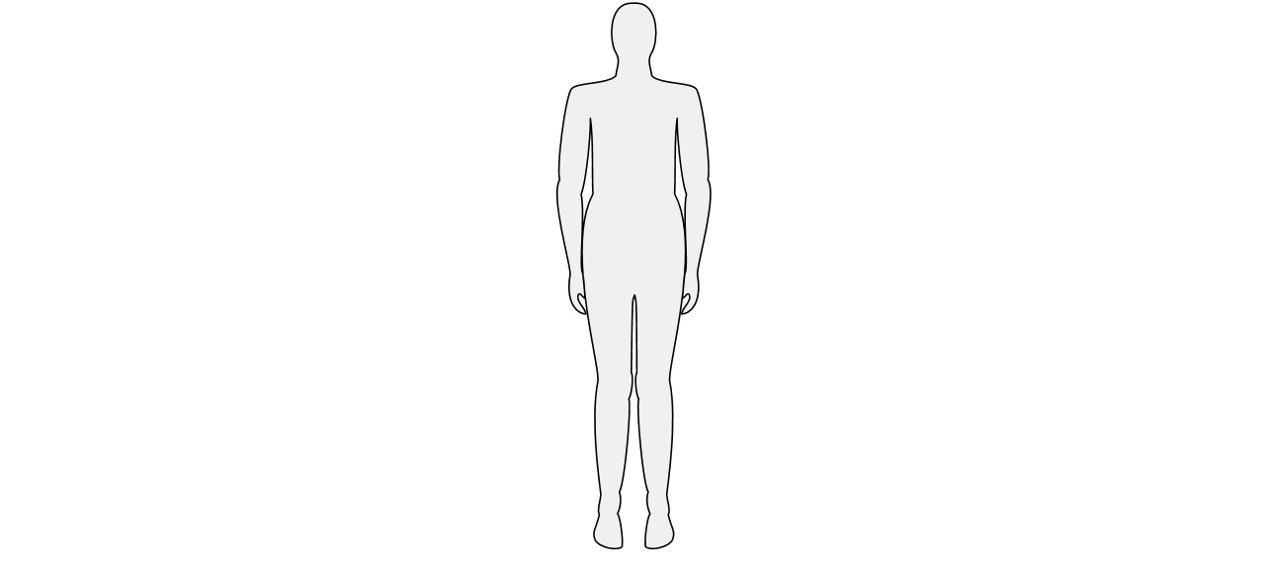
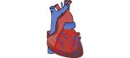
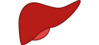
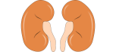
When a drug is absorbed its concentration in plasma rises with the time T_{max} to a maximal concentration C_{max}.
Via the blood stream the drug is distributed into the different tissues.
Mostly in the liver the drug is metabolized (chemically transformed)
Excretion of drugs and their metabolites leads to a decline of the plasma concentration over time.
12
Distribution
10
C_{max}
Metabolism
8
Excretion
Concentration (mg/L)
Absorption
6
T_{max}
Elimination
4
2
0
0
2
4
6
8
(a)
(b)
Time (hours)
The plasma concentration of a drug as a function of time is called pharmacokinetic.

Slide 9
Pharmacodynamic(PD): What a drug does to the body
Pharmacokinetic(PK): What the body does to the drug
PD and PK are equally important optimization parameters in drug discovery

Slide 10
Pharmacokinetic Profile
10
8
6
Drug concentration (mg/L)
4
2
0
0
2
4
6
8
10
12
Time (hours)
No pharmacological effect anymore

Slide 11
The factors which shape the PK-profile of a drug are:
Absorption
Distribution
Metabolism
Excretion

Slide 12
Absorption
Absorption occurs mainly in the small intestine
Before a drug can be absorbed it must dissolve. This is often called Liberation.
The critical molecule property to achieve sufficient liberation is aqueous solubility at the pH of the small intestine (~8)

Slide 13
Absorption
How well an organic molecule dissolves in water is determined by the free energy of solvation ΔG_{solv}
The question is basically how much is the solid (crystalline/amorphous) state preferred over the individual molecules being solvated by water molecules.
Poor solubility can have two reasons:
High lipophilicity (high logP)
Strong self-interactions
clogP = 3.3
Sol = 31μg/ml
clogP = -0.7
Sol = 69μg/ml
Napthalene
Xanthine

Slide 14
Increase of molecular weight and logP has usually a negative impact on solubility.
Introducing polar groups usually increases solubility
(1)
100 ug/mL
(2)
18 ug/mL
logP = 2.2
Increased chain length
logP = 2.6
(3)
42 ug/mL
Add hydrogen bond acceptor
(4)
100 ug/mL
logP = 2.5

Slide 15
(7)
0.06 μg/mL
(5)
1.15 μg/ml
Add polar groups
Add polar groups
(6)
6.5 μg/ml
(8)
4.6 μg/mL

Slide 16
(9)
1 mg/mL
(10)
50 mg/mL
Isosteric replacement
(11)
Solubility: 5 µg/mL
(12) Solubility: 610 µg/mL
Add ionizable group

Slide 17
(13)
8.4 ug/mL
(14)
80 ug/mL
Flat, disc-like structures are often poorly soluble due to pi-stacking interactions
Adding 3D structural elements to a molecule often increases solubility

Slide 18
Permeability
After dissolvation drugs must permeate through the gut wall to reach systemic circulation.
Permeation through biological membranes (lipid bilayer) requires that the drug molecules strip off their hydration shell, permeate through the membrane and enter the aqueous phase on the other side.
Charged or very polar molecules permeate poorly through biological membranes

Slide 19
There are different mechanisms by which molecules can cross biological membranes
Passive diffusion
Active transport
Endocytosis
Efflux
Paracellular transport
For drug-like molecules passive diffusion is the most relevant permeation pathway
Efflux becomes relevant when the drug is actively pumped out of the cell by specific transporters

Slide 20
10X increased permeability
Ciprofloxacin
10X increased permeability
GS-4071
Tamiflu®
Charged molecules are poorly permeating

Slide 21
25X increased permeability
18X increased permeability
pKa = 8.51
pKa = 10.56
pKa = 8.88
For basic compounds, tweaking the pKa of the basic group by electron withdrawing groups is an option to increase permeability.

Slide 22
10 x increased permeability
cLogP = 1.73
cLogP = 3.17

Slide 23
There are also examples where reduction of lipophilicity increases permability.
With a logP of 5.5 the initial compound, however, is very lipophilic
cLogP = 5.55
8X increased permeability
cLogP = 4.80
2X increased permeability
cLogP = 3.86

Slide 24
Efflux-Transporters
Biological membranes contain proteins which are specialized for the active transport of molecules in and out of cells.
Some them are substrate-specific (e.g. for sugar) whereas others recognized a wide range of different chemotypes.
If a drug candidate is a substrate of a transporter it is actively pumped out of the cell, resulting in poor permeability despite favorable physico-chemical properties.

Slide 25
The most important efflux transporter is P-glycoprotein 1 (permeability glycoprotein, P-gp)
Some cancer cells overexpress P-gp which has the pharmacologic effect that drugs which are a P-gp substrate are actively pumped out of the cancer cell causing resistance to therapy. For this reason P-gp is also known as multidrug resistance protein 1 (MDR1).
If a cancer cell overexpresses P-gp as a consequence of pharmacological treatment it becomes resistant to other therapeutics, too. Even though the patient might have never been treated with it.
Besides P-gp, BCRP (breast-cancer resistance protein) is an important transporter which can impact efficacy of a drug.

Slide 26
Blood-Brain-Barrier
The blood brain barrier is special biological membrane which is passively permeable only for small lipophilic molecules as well as for gases and water.
Transporters like P-gp are highly expressed in the BBB. Molecules which are P-gp substrates are therefore not suitable as drugs which address targets in the CNS.
Endothelial cell
Astrocyte
Pericyte
Efflux transporter
Tight junction
Capillary lumen
P-gp substrates:
Astrocyte
Concentration of drug in the periphery is (much) higher than in the brain.
Astrocyte
Neuron

Slide 27
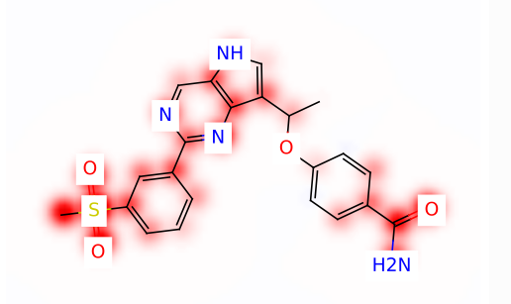
P-gp transporters recognize polar groups, in particular carbonyl and sulfonyl groups.
Computer prediction of chemical groups in a molecule which are most likely responsible for P-gp efflux.

Slide 28
Loperamide
Opiod-receptor agonist
Fentanyl
Opiod-receptor agonist
50-100 times more potent than heroin
Strong pain medication, thousands of overdose deaths between 2000-2015

Slide 29
Efflux
Loperamide is a P-gp substrate
When taken orally it has a bioavailability of only 0.3 %
It also does not cross the blood-brain-barrier due to P-gp efflux.
Opiod-receptor in the large intestine
In the case of Loperamide P-gp efflux is beneficial since it keeps the drug at its side of action and prevents systemic circulation which would lead to severe side-effects.

Slide 30
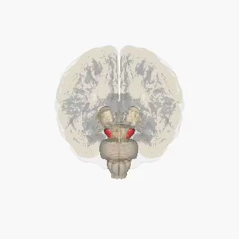
Parkinson’s disease is a disease of the brain which results in progressive loss of dopaminergic neurons in the substantia nigra.
Dopamin
The lack of Dopamin in the brain causes severe movement disorders and other symptoms.
Substitution therapy with Dopamin would help to alleviate the symptoms, however, Dopamin, when given orally, is not able to cross the blood brain barrier.

Slide 31
In the blood-brain barrier the large amino acid transporter (LAT1) is expressed which is needed to shuffle branched aliphatic and aromatic amino acids into the CNS.
Conversion of Dopamin into an amino acid leads to L-Dopa which is actively transported into the brain by the LAT.
LAT1
In the CNS L-Dopa is enzymatically converted into Dopamin.

Slide 32
Plasma - Protein Binding
Blood plasma contains a multitude of proteins to which organic molecules can bind
Albumin ~ 35-50 g/L (400-700 μM)
α₁-acid glycoprotein ~ 0.5-1.2 g/L
Immuneglobulins ~ 8-20 g/L
Many drugs are highly bound to plasma proteins
Name | Plasma Protein Binding | Use
Diazepam (Valium®) | 99% | Antianxiety agent
Ibuprofen (Advil®) | 99% | Antiinflammatory
Lorazepam (Ativan®) | 92% | Antianxiety agent
Naproxen (Aleve®) | 99% | Antiinflammatory
Amlodipine (Norvasc®) | 93% | Antihypertensive
Omeprazole (Prilosec®) | 95% | Proton pump inhibitor
Doxycycline (Vibramycin®) | 90% | Antibiotic
Efavirenz (Sustiva®) | 99% | Antiviral

Slide 33
Plasma - Protein Binding
Drug molecules which are bound to plasma protein cannot permeate across biological membranes.
The fraction of drug molecules which are not bound to plasma protein is called the fraction unbound f_{u}
Only drug molecules which are not bound to plasma protein can act on the target or be metabolized.
X

Slide 34
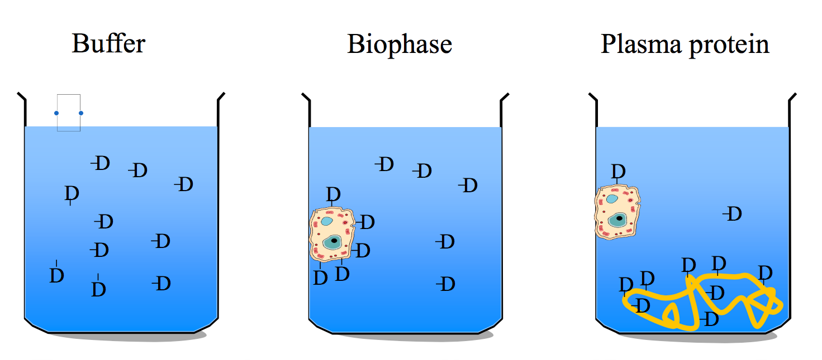
Plasma proteins ”absorb” drug molecules which results in a (substantially) reduced concentration of free drug.

Slide 35
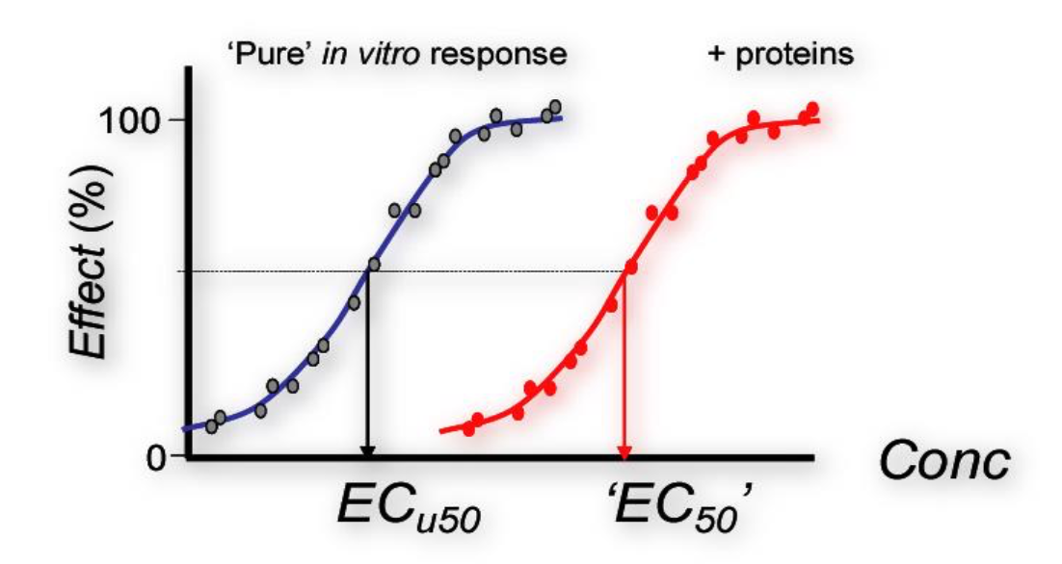
In an in-vitro system plasma protein binding results in a lower effective concentration which leads to a shift of the dose-response curve.

Slide 36
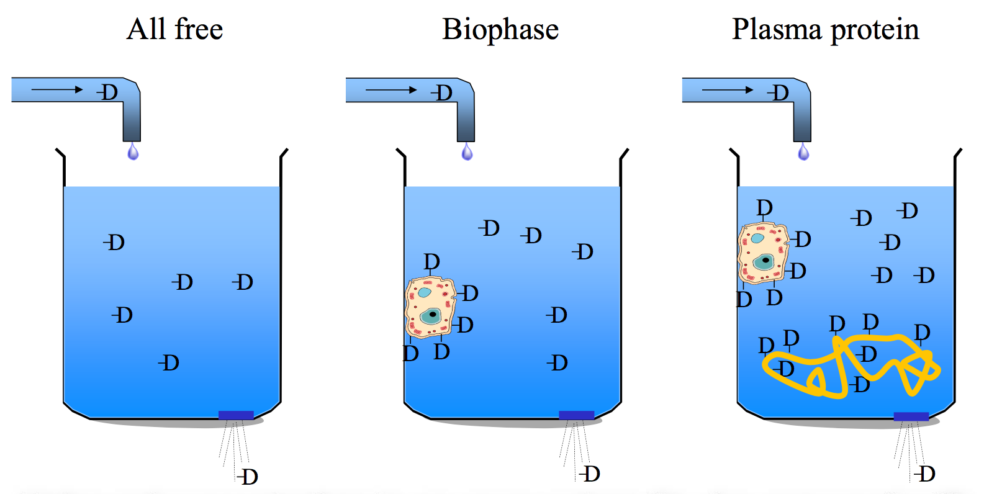
In an open system drug is repeatedly dosed and cleared. So in most cases plasma protein binding is not an optimization parameter for drug discovery.
However it is important to know the degree of plasma protein binding to adjust the dose for single dose experiments.

Slide 37
Metabolism
Metabolism is the umbrella term for all chemical transformations substances undergo in a living organism.
Gastrointestinal Tract
Portal vein
Liver
Systemic circulation
The most important organ for metabolism is the liver where numerous enzymes are located which are able to chemically transform organic molecules.

Slide 38
Organic molecules which do not normally occur in living systems (like drugs) are called Xenobiotics.
From an evolutionary aspect it has apparently been beneficial to develop a variety of enzymes which are able to chemically modify xenobiotics. These modifications follow the general paradigm:
Make it soluble and get it out of the body

Slide 39
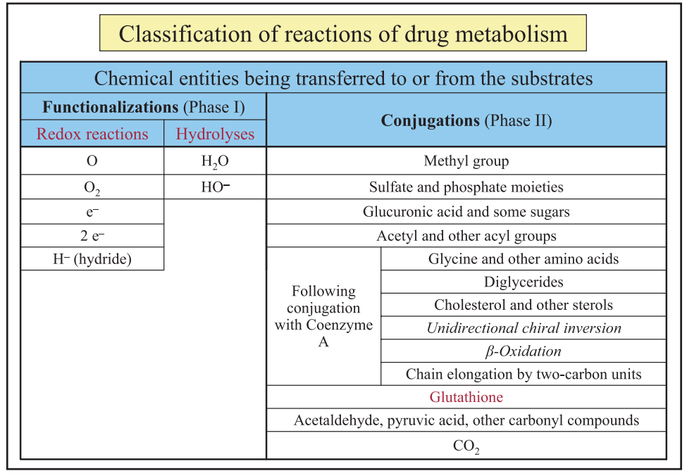

Slide 40
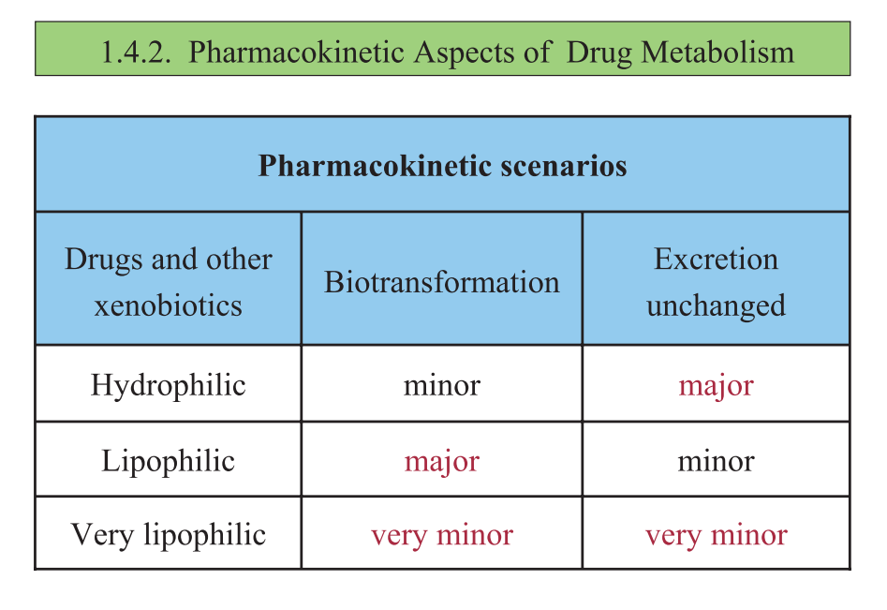

Slide 41
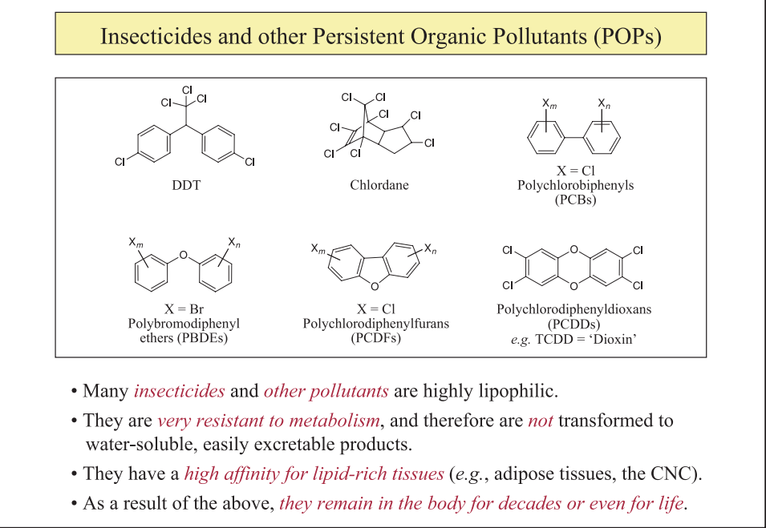

Slide 42
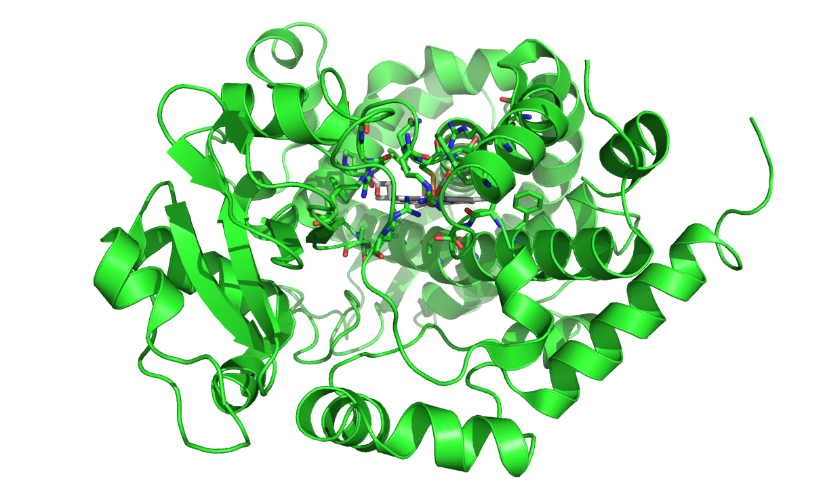
Phase I metabolism (oxidation) is mainly performed by enzymes which belong to the Cytochrome P450 family
Fe-containing Heme group
CYP P450 3A4

Slide 43
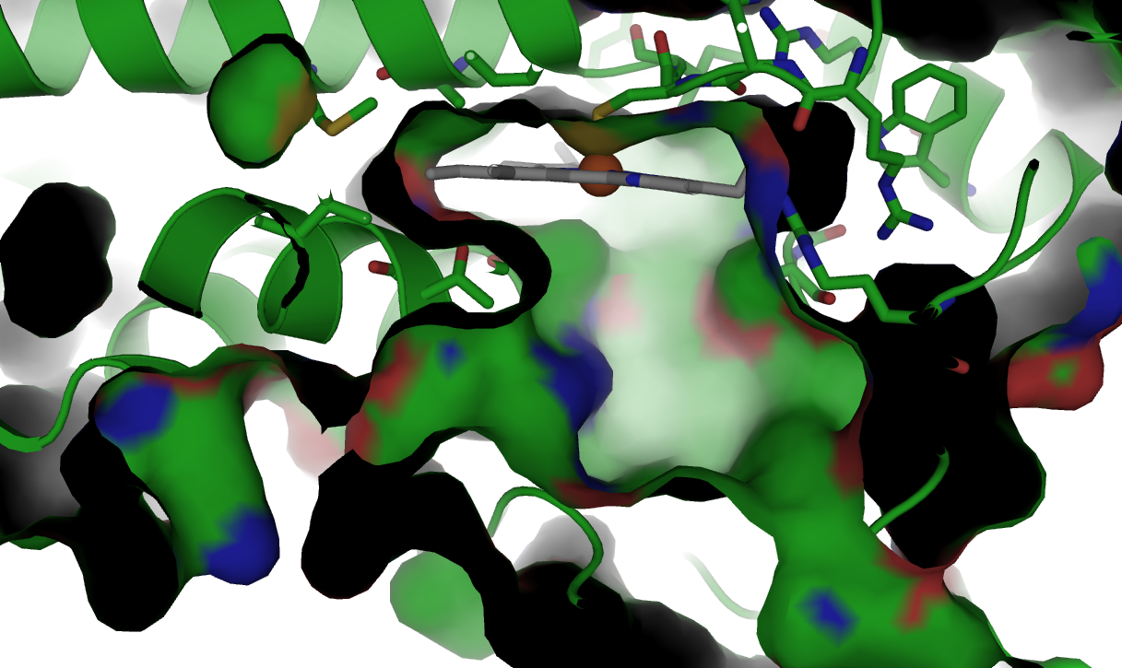
CYP P450 3A4 has a large binding sites which is mostly lipophilic. Therefore lipophilic compounds have a higher affinity for CYP 3A4 enzymes than polar compounds.

Slide 45
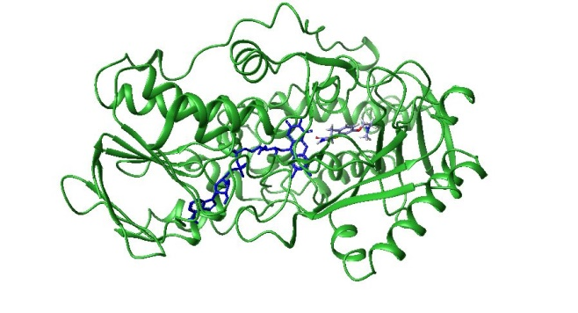
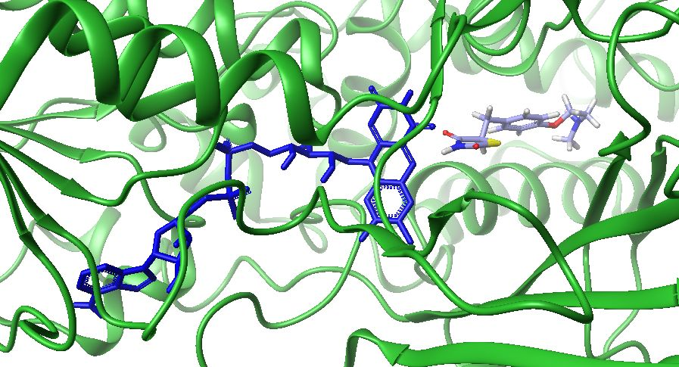
Flavin oxidases (MAO-B)
(a)
(b)
(c)
Flavin adenine dinucleotide

Slide 46
Chemical transformations catalyzed by CYPs and other oxidation enzymes

Slide 47
Phase II metabolism are chemical reactions which add solubilizing groups to a molecule
(a)
(b)

Slide 49
Certain chemical groups represent metabolic hotspots
Demethylation
Hydroxylation
Glucoronidation

Slide 50
Metabolic stability is tested in cell culture containing human liver microsomes or rat liver microsomes which express most enzymes which are relevant for metabolism.
The results are either given as intrinsic clearance (Cl_{int}) given in volume of blood which is cleared from drug per time and liver mass, or as %QH which the fraction of drug cleared from the blood in during one passage of the liver.
HLM Clint
112 μl/min/mg
HLM Clint
28 μl/min/mg
Removal of the phenyl ring improves stability in human liver microsomes.

Slide 51
<5% remaining
RLM @30 min
96% remaining
RLM @30 min
Benzylic positions are often oxidized to the corresponding alcohol.
Blocking of the metabolic hotspot with fluorine improves metabolic stability.

Slide 52
HLM T_{1/2} 10 min.
HLM T_{1/2} 87 min.
Pyridine to Piperidine reduces lipophilicity which reduces affinity for CYP.
Unsubstituted pyridines also have a preference to bind to the ion atom of the heme group in CYPs.

Slide 53
The para – position of phenyl-rings is often rapidly oxidized to the phenol
Metabolism can be blocked by substitutions in para-position, e.g. CF₃ ,Cl or F

Slide 54
MLM Clint
462 μL/min/mg
MLM Clint
37 μL/min/mg
Metabolism-sensitive position in the aryl system is blocked with a chlorine

Slide 55
HLM Clint
232 (mL/min/kg)
HLM Clint
35 (mL/min/kg)
HLM Clint
6 (mL/min/kg)
The metabolic hotspot at the cyclohexyl ring is blocked by fluorine.
Hydroxylation of the amide reduces lipophilicity and blocks metabolic hotspot.

Slide 56
RLM Clint
170 ml/min/kg
RLM Clint
95 ml/min/kg
RLM Clint
40 ml/min/kg
Primary and secondary alcohols can be oxidized to the aldehyde, acid or ketone. For tertiary alcohols this pathway does not exist.

Slide 57
RLM Clint
35 (mL/min/kg)
RLM Clint
2.8 (mL/min/kg)
Piperidine to morpholine substitution blocks oxidation hotspot and reduces lipophilicity.

Slide 58
HLM T_{1/2} 27 min.
HLM T_{1/2} >120 min.
Electron-rich 5-ring aryl systems often have poor stability against metabolic conversion.
Electron-withdrawing substituents are a way to increase metabolic stability for these heterocycles.

Slide 59
Excretion
Unchanged drugs and their metabolites are removed from the body through excretion into urine, sweat, bile, breast milk or into expired air through the lung.
The two most important elimination pathways are excretion into urine by the kidneys and deposition into bile fluids by the liver.

